Slide 1
BOOK A TABLE (A RESTAURANT BOOKNG WEBSITE)
TEAM
23R01A6710 Ch Pradeeptha
23R01A6714 G Manikanta
23R01A6731 M Tejaswini
23R01A6737 N Mahitha
PROJECT GUIDE:
Mr.. Kannan
Assistant Professor

Slide 2
ABSTRACT
Online restaurant booking platforms simplify the dining experience by allowing users to easily reserve tables across various restaurants. However, users often encounter challenges such as inconsistent availability, unverified restaurant information, and a lack of personalized recommendations. Traditional booking systems rely on basic filters and manual inputs, leading to inefficiencies. This project proposes an intelligent restaurant booking system that leverages machine learning algorithms to offer real-time, personalized restaurant suggestions based on user preferences, location, and availability. The system incorporates advanced filtering and ranking techniques to provide tailored recommendations, ensuring a smooth and efficient reservation process. By integrating real-time availability, dynamic booking management, and automated confirmation, the platform eliminates common issues like double bookings and outdated information. This solution enhances user satisfaction by offering accurate, convenient, and quick reservations, making it a more effective alternative to traditional methods and improving the overall restaurant booking experience.

Slide 3
INTRODUCTION
BOOK A TABLE, your ultimate destination for seamless dining reservations. Whether you're planning a casual meal, a romantic dinner, or a business gathering, we offer a wide variety of restaurants to choose from, catering to every taste, preference, and occasion. Our platform allows you to easily explore diverse dining options, from local favorites to world-class fine dining establishments, all in one place. With real-time availability and user-friendly features, booking a table has never been easier. Simply browse through our extensive list of restaurants, view menus, check reviews, and secure your reservation with just a few clicks. Whether you're looking for a cozy café, a trendy bistro, or an upscale restaurant, BOOK A TABLE ensures that you find the perfect spot to enjoy a memorable dining experience. Let us make your next meal out effortless and enjoyable!

Slide 4
OBJECTIVE
Streamline the Booking Process: Develop an intuitive and user-friendly platform that allows users to easily browse, search, and book reservations at multiple restaurants based on location, cuisine, and preferences.
Real-time Availability and Instant Reservations: Integrate real-time availability and instant booking functionality to ensure users can secure their reservations without delays or conflicts.
Personalized Recommendations: Leverage user preferences, dining history, and location to provide tailored restaurant suggestions, improving the overall user experience.
Enhance User Engagement: Offer exclusive promotions, deals, and loyalty programs to incentivize users and encourage repeat bookings.

Slide 5
LITERATURE SURVEY
Rule-based Detection - Rule-based methods identify fake reviews or bookings through keywords, duplicate content, or extreme sentiment. .
Machine learning approaches - Algorithms like SVM, Random Forest, and Logistic Regression detect fraud by classifying booking patterns.
Deep learning approaches - Deep learning models like CNNs and LSTMs can detect anomalies in booking data.
Graph-based approaches - Graph Neural Networks (GNNs) model users and restaurants as nodes to identify fraud in interconnected networks.
Gap in Literature: Current methods struggle with detecting fraud networks where fraudsters work together. HGT-based approaches overcome this by capturing complex, dynamic relationships between users, restaurants, and bookings.

Slide 6
EXISTING SYSTEM
Basic Search and Filter Options: Existing platforms allow users to search for restaurants based on location, cuisine, and price range. They also provide basic filtering features but may lack advanced customization.
Reservation Management: Users can check real-time availability and make reservations instantly at selected restaurants. However, conflicts like double bookings can still occur without proper dynamic management.
Restaurant Listings and Reviews: Restaurants are listed with ratings, reviews, and menus. Users rely on these reviews for decision-making, though the system may struggle with fake or biased reviews.

Slide 7
LIMITATIONS OF EXISTING SYSTEM
Personalization is often limited, with recommendations being generic and not tailored to individual user preferences or dining history.
Real-time availability can sometimes be inaccurate, leading to double bookings or reservations that no longer exist, frustrating users and restaurant owners.
Fake reviews and biased ratings can mislead users, as many platforms still rely heavily on user-generated content that may be manipulated or unreliable.
Scalability issues arise, especially when handling high volumes of bookings across multiple restaurants, leading to delays or reservation management problems during peak times.
Fraud detection methods are basic, often relying on simple algorithms or rule-based systems, failing to identify sophisticated fraudulent behaviors or coordinated manipulation between users and restaurants.

Slide 8
PROPOSED SYSTEM
Utilize machine learning algorithms to provide personalized restaurant recommendations based on user preferences, dining history, location, and reviews for more tailored suggestions.
Integrate dynamic booking management systems that sync in real-time with restaurant availability, preventing double bookings and ensuring accurate reservation details.
Implement fraud detection mechanisms, such as sentiment analysis and AI-powered verification tools, to identify fake or biased reviews, ensuring that user reviews are reliable and trustworthy.
Design a robust, cloud-based infrastructure that can handle high volumes of traffic and reservations, allowing the platform to scale efficiently during peak times without affecting performance.

Slide 9
ADVANTAGES OF PROPOSED SYSTEM
Provides highly personalized restaurant recommendations based on user preferences and past behaviors, enhancing user satisfaction and engagement.
Ensures real-time, accurate availability of restaurant bookings, preventing double bookings and improving the overall reservation experience.
Improves trust and reliability by detecting and filtering out fake or biased reviews, offering users genuine insights for better decision-making.

Slide 10
ALGORITHMS
Collaborative Filtering: Used for personalized restaurant recommendations based on user preferences, previous bookings, and similar users' actions. It helps suggest restaurants that a user might like based on the preferences of others with similar tastes.
Random Forest (RF): Can be applied for fraud detection by classifying user behaviors as legitimate or fraudulent. Random Forest is effective for handling large datasets and identifying patterns in booking and review data that could indicate fraudulent activity.
K-Nearest Neighbors (KNN): Used for detecting anomalies in restaurant booking patterns by comparing a user’s booking behavior to others. It can help identify suspiciously repetitive or abnormal activities, which may indicate fraud.
Support Vector Machine (SVM): Used for classification tasks like distinguishing between valid and fraudulent reviews or booking behaviors based on various features such as time, frequency, and sentiment.

Slide 11
Deep Learning (LSTM/CNN): Long Short-Term Memory (LSTM) or Convolution Neural Networks (CNN) can be used to analyze time-series data or patterns in booking behaviors, helping detect anomalies or patterns related to fraudulent actions over time.
Sentiment Analysis (Natural Language Processing): Applied to review text to detect fake reviews or manipulate reviews based on the sentiment (positive, negative, or neutral). NLP models can help identify inconsistencies or patterns that suggest fraudulent content.
Decision Trees: Can be used to predict whether a restaurant will have availability based on booking trends and past data. They can also help in fraud detection by analyzing various factors such as booking frequency, cancellation rates, and user behaviors.

Slide 12
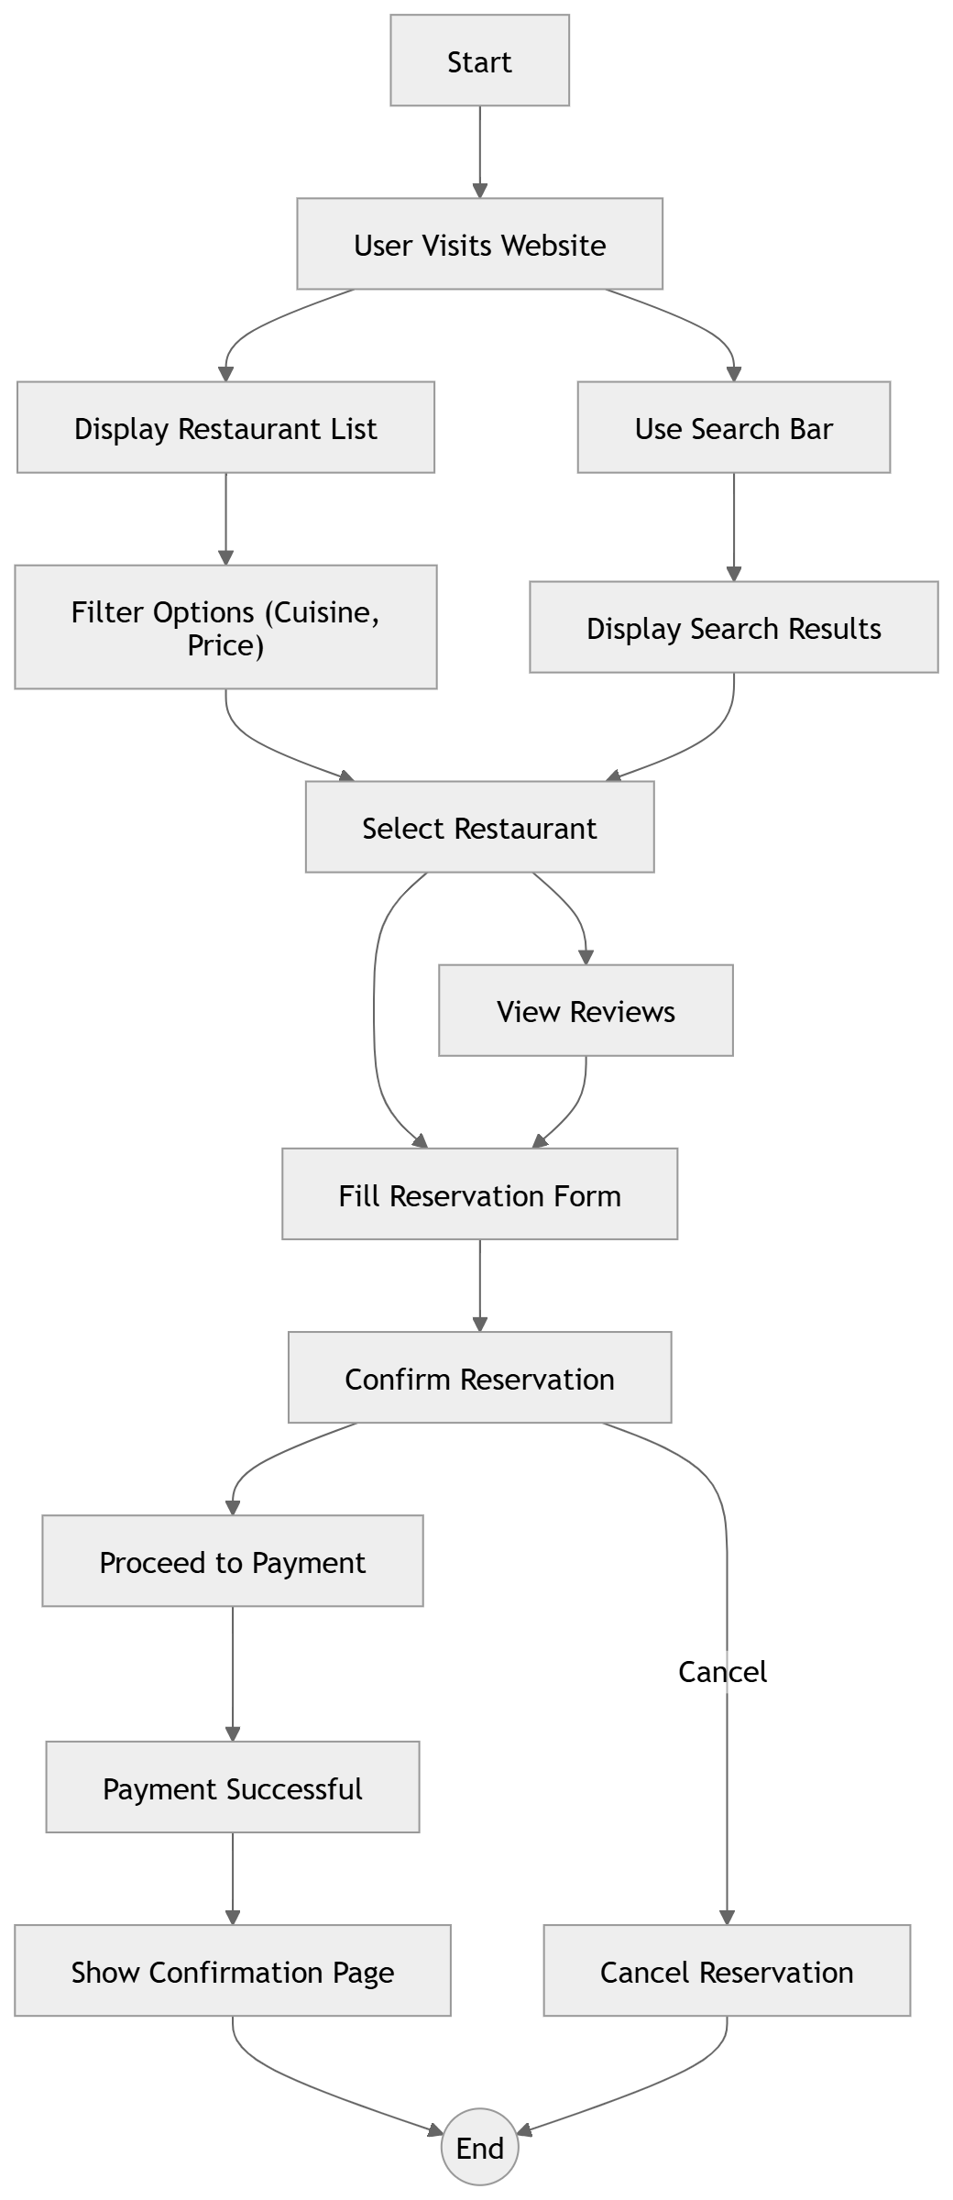
SYSTEM ARCHITECTURE

Slide 13
MODULES
User Modules (Service Provider Side):
Reservation Submission Module: Allows users to make restaurant reservations by selecting a restaurant, date, time, and number of people, with immediate confirmation.
Restaurant Search & Filter Module: Enables users to search for restaurants based on preferences like location, cuisine, price range, and ratings.
Review Submission Module: Allows users to submit text reviews and ratings for restaurants, including photos and additional feedback on the dining experience.
Data Collection Module: Collects and securely stores user interactions, booking history, and reviews for future analysis and personalized recommendations.
Review Analysis Module: Analyzes reviews for potential fraud, providing a credibility score to help users identify genuine reviews.

Slide 14
MODULES
Admin Modules (System Side):
Data Cleaning Module: Removes spam, duplicate reviews, and irrelevant data to ensure clean, trustworthy content for analysis.
Graph Creation Module: Builds a user-review-restaurant network to analyze relationships and connections between users, reviews, and restaurants.
HGT Model Training Module: Trains the Heterogeneous Graph Transformer (HGT) model to identify patterns and detect fake reviews by analyzing the graph structure.
Fraud Detection Module: Flags suspicious or fake reviews and assigns a fraud score based on detected anomalies and patterns in review data.
Admin Dashboard Module: Provides administrators with a user-friendly dashboard to view, manage, and take actions on flagged or suspicious reviews.

Slide 15
CONCLUSION
In conclusion, the proposed restaurant booking website with multiple restaurant options aims to provide a seamless, user-friendly experience while maintaining high standards of security and integrity. By implementing advanced modules on both the user and admin sides, the system ensures that customers can make informed decisions through personalized recommendations and reliable reviews. At the same time, administrators can efficiently detect and manage fraudulent activities, maintaining the trustworthiness of the platform. The integration of modern technologies, such as machine learning models and graph-based analysis, enhances the platform’s ability to handle complex tasks, improve scalability, and offer accurate fraud detection. Ultimately, this system is designed to enhance both the user experience and the operational efficiency of restaurant bookings, ensuring a secure and enjoyable dining experience for all users.

Slide 16
FUTURE ENHANCEMENT
Implement AI-driven chat bots to assist with restaurant recommendations, booking, and customer support.
Introduce a dynamic pricing system based on demand, time, or season to optimize availability and costs.
Launch a loyalty and rewards program to encourage repeat bookings and reviews, enhancing user retention.
Enhance fraud detection with deep learning and anomaly detection techniques for more accurate identification of fraudulent activities.
Add a real-time waitlist feature to notify users when a spot becomes available at fully booked restaurants.
Integrate augmented reality (AR) for virtual tours of restaurants and seating options to improve decision-making.
Enable voice assistant integration for hands-free bookings and inquiries, improving accessibility and convenience.

Slide 17
REFERENCES
Li, J., Liu, L., & Zhang, Y. (2020). "A survey on recommendation systems and applications." Journal of Intelligent & Fuzzy Systems, 38(5), 5517-5534.
Zhao, Z., & Liu, C. (2019). "Deep learning for restaurant reviews: A comparative study." International Journal of Information Technology & Decision Making, 18(3), 841-863.
Cheng, L., & Wu, W. (2018). "Fraud detection in online reviews: A deep learning approach." Proceedings of the IEEE International Conference on Big Data (Big Data), 1-9.

Slide 18


